Slide 1

Tea drinks
Doehler solutions for soft drinks
Doehler product solutions and packaging capability
Category of Soft Drinks for Food service consist of wide variety of subcategories: flavoured waters, carbonated soft drinks, frozen tea & coffee, still drinks and splashes. They are produced either from the scratch at the restaurant counter or composed from semi – ready ingredients/bases.
Doehler offers diverse portfolio of products/solutions which can be used by QSR players, among them are: syrups (flavoured, functional, energy, juice containing), RTD syrups, compounds (fruit, berries, vegetable, herbs and botanical based), coffee and tea bases.
Packaging solutions vary from one sub-category from another based on the application protocol

Slide 2
Tea drinks
Still and sparkling soft drinks (Refreshers, lemonades, Splashes)
Soft drink syrups, Energy drinks syrups, Functional syrups, Bases
Product example
Recommended Application
Syrups
B16253 Orange-Lemon-Raspberry Base
Flavouring Syrups
RTD Syrups
Functional Syrups
Product and Packing capabilities
Product Information | Shelf Life 9 months @ ambient storage Open shelf life 3 days @ chilled storage/ 24h @ ambient storage
MOQ | Döhler: 1.000-3.000kg l Bottler: 40.000l
PET Squeeze500-1000ml
BIB 3l 10l)
Carton 500ml-1000 ml
Co-Packer & Packaging | DMK/ Immergut (depending on potential/ business case) l 1L Carton
Güldenkron (PET , Carton)
Güldenkron ( Carton , PET)
tbottlers GmbH ( PET )

Slide 3
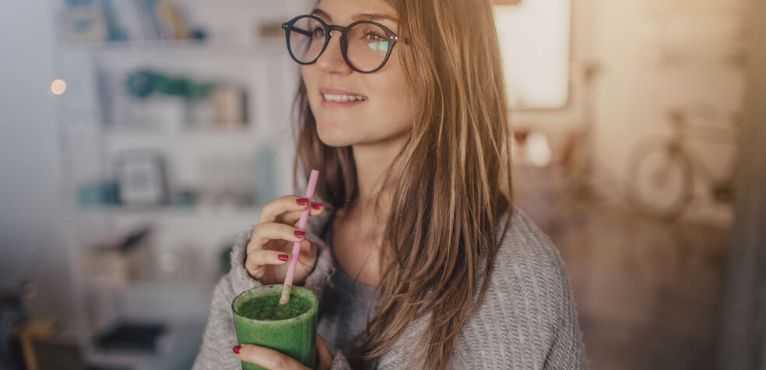
Tea drinks
Doehler solutions for smoothies, juice and snack drinks
Doehler product solutions and packaging capability
Juice, snack drinks and smoothies are the drinks with high fruit content varies from 25 up to 100%. For their production can be used fresh or frozen fruits/berries or purees wither in pure form or mixed with milk (dairy or plan based), yogurt, sparkling or still water. Smoothies/snack drinks provide the satiety and nutrition being complimented with herbal or botanical touch, plant protein or any other personalized healthy ingredient.
Doehler offers juice containing fruit compounds and smoothie bases which can be used pure, mixed with water/milk and served on ice. Packaging solutions vary from one sub-category from another based on the application protocol

Slide 4
Product and packaging info
Smoothies and snack drinks
Fruit and veggie smoothie blends
Product example
Recommended Application
CR0338121 Multifruit smoothie yellow with mint
Juices & Juice Drinks
Ready to drink, to be served on ice
Juices
Nectars
Smoothies
Product and Packing capabilities
Product Information | Shelf Life 9 months @ ambient storage Open shelf life 3 days @ chilled storage/ 24h @ ambient storage
MOQ | Döhler: 1.000-3.000kg l Bottler: 40.000l
PET 500-1000ml
BIB 3l 10l)
Carton 500ml-1000 ml
Co-Packer & Packaging | DMK/ Immergut (depending on potential/ business case) l 1L Carton
Güldenkron (PET , Carton)
Güldenkron ( Carton ,PET)
tbottlers GmbH (PET Carton ) Dohrn & Timm GmbH ( Carton )

Slide 5
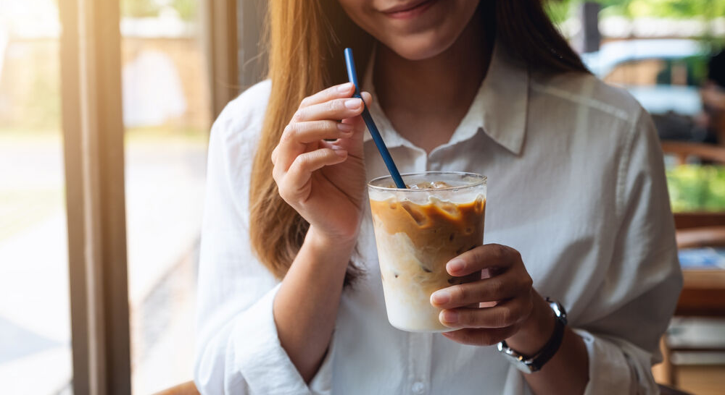
Tea drinks
Doehler solutions for cold tea and coffee drinks
Doehler product solutions and packaging capability
Cold tea drinks in QSR and coffee shops are made of tea bases (in-house produced), concentrated tea bases or compounds for further dilution with water/served on ice.
Cold coffee drinks are getting popularity Globally (mainly during the warm seasons) due to their energizing and refreshing features as well as the uniqueness and personalized product portfolio
For the creation of portfolio of cold tea and coffee drinks Doehler offers juice containing fruit compound with tea extracts, tea bases (black, white, green, matcha etc), cold and hot brewed coffee

Slide 6
Product and packaging info
Cold Tea and Coffee drinks
Fruit Bases, Syrups, Bases with tea extracts, Tea bases, Cold and hot brew coffee
Product example
Recommended Application
Syrups
H89558 Green tea mango syrup
To mix with water in proportion 1/4
Product and Packing capabilities
Flavouring Syrups
RTD Syrups
Functional Syrups
Product Information | Shelf Life 9 months @ ambient storage Open shelf life 3 days @ chilled storage/ 24h @ ambient storage
MOQ | Döhler: 1.000-3.000kg l Bottler: 40.000l
PET Squeeze500-1000ml
BIB 3l 10l)
Carton 500ml-1000 ml
Co-Packer & Packaging | DMK/ Immergut (depending on potential/ business case) l 1L Carton
Güldenkron (PET , Carton)
Güldenkron ( Carton , PET)
tbottlers GmbH ( PET )

Slide 7
Product and packaging info
Cold Brewed Coffee
Product example
Recommended Application
CR0277625 Cold brew coffee
Ready to drinks, served on ice, with plant-based milk/syrups, toppings
Tea & Coffee Drinks
Product and Packing capabilities
Tea Drinks
Coffee Drinks
Herbal Drinks
Shelf Life 360 days @ chilled storage / 180 days @ ambient storage Open shelf life 3-5 days @ chilled storage
Döhler: 2.000kg l Bottler: 10.000l
PET 500-1000ml
BIB 3l 10l)
Carton 500ml-1000 ml
Co-Packer & Packaging | lGüldenkron l Tetra 1L Carton
Güldenkron (PET , Carton)
Naarmann ( Carton)
Güldenkron ( Carton , PET)
tbottlers GmbH ( PET, Carton)

Slide 8
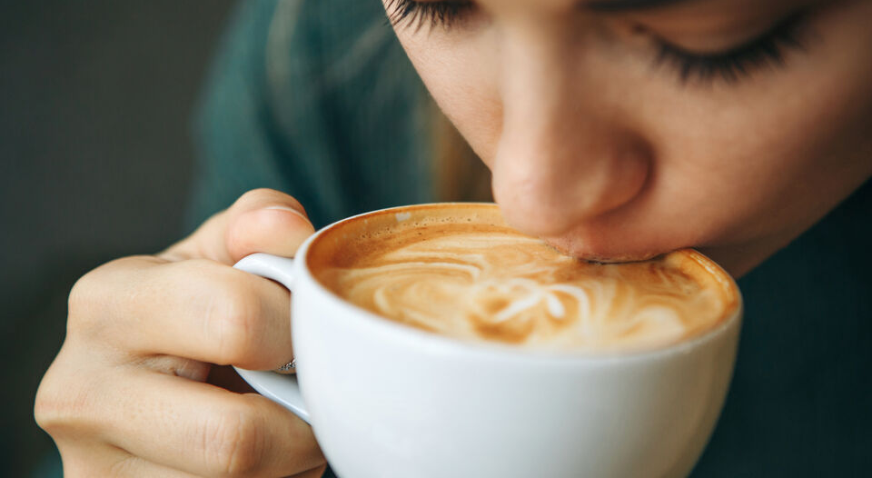
Tea drinks
Doehler solutions for hot tea and coffee drinks
Doehler product solutions and packaging capability
Differentiation of hot coffee and tea drinks portfolio goes via addition of dairy, fruity ingredients as well as natural sweeteners, herbs and spices. Hot fruited tea complimented with honey and spices warms up through the cold seasons.
Traditional hot coffee range can be differentiated by adding the taste via syrups, sauces, plant-based milk or crunchy dried fruit inclusions.
For Hot tea and coffee drinks Doehler offers wide range of syrups (fruited, brown flavored, with/without sugar), sauces, toppings and frieze dried fruits in slices, cubes, granules and powder form.

Slide 9
Product and packaging info
Hot tea and coffee drinks
Fruit Bases, Syrups, Bases with tea extracts
Product example
Recommended Application
Syrups
CR0338121 Multifruit smoothie yellow with mint
Flavouring Syrups
RTD Syrups
Functional Syrups
Product and Packing capabilities
Product Information | Shelf Life 9 months @ ambient storage Open shelf life 3 days @ chilled storage/ 24h @ ambient storage
MOQ | Döhler: 1.000-3.000kg l Bottler: 40.000l
PET Squeeze500-1000ml
BIB 3l 10l)
Carton 500ml-1000 ml
Güldenkron (PET , Carton)
Co-Packer & Packaging | DMK/ Immergut (depending on potential/ business case) l 1L Carton
Güldenkron ( Carton , PET)
tbottlers GmbH ( PET )

Slide 10
Product and packaging info
Freeze dried fruits for cold and hot drinks
Fruit powder, granules, crispies, slices, cubes
Product example
Recommended Application
CR0338121 Multifruit smoothie yellow with mint
Product and Packing capabilities
Product Information | Shelf Life 9 months @ ambient storage Open shelf life 3 days @ chilled storage/ 24h @ ambient storage
MOQ | Döhler: 1.000-3.000kg l Bottler: 40.000l
Co-Packer & Packaging | DMK/ Immergut (depending on potential/ business case) l 1L Carton

Slide 11
Tea drinks
Plant-based milk for cold and hot drinks
Doehler product solutions and packaging capability
Differentiation of hot coffee and tea drinks portfolio goes via addition of dairy, fruity ingredients as well as natural sweeteners, herbs and spices. Hot fruited tea complimented with honey and spices warms up through the cold seasons.
Traditional hot coffee range can be differentiated by adding the taste via syrups, sauces, plant-based milk or crunchy dried fruit inclusions.
For Hot tea and coffee drinks Doehler offers wide range of syrups (fruited, brown flavored, with/without sugar), sauces, toppings and frieze dried fruits in slices, cubes, granules and powder form.

Slide 12
Product and packaging info
Plant-based drinks for cold and hot drinks
Plant-based milk and cream range, Barista milk
Syrups
Product example
Recommended Application
CR0338121 Multifruit smoothie yellow with mint
Flavouring Syrups
RTD Syrups
Functional Syrups
Product and Packing capabilities
Product Information | Shelf Life 9 months @ ambient storage Open shelf life 3 days @ chilled storage/ 24h @ ambient storage
MOQ | Döhler: 1.000-3.000kg l Bottler: 40.000l
PET Squeeze500-1000ml
BIB 3l 10l)
Carton 500ml-1000 ml
Güldenkron (PET , Carton)
Co-Packer & Packaging | DMK/ Immergut (depending on potential/ business case) l 1L Carton
Güldenkron ( Carton , PET)
tbottlers GmbH ( PET )

Slide 13
Notes
Hans im Gluck

Slide 14
DÖHLER SCANDINAVIA A/S
DK- 4030 Tune
Mailbox.dk@doehler.com www.Doehler.com

Slide 15
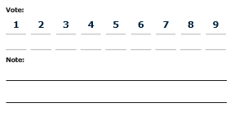
Tea drinks
Syrups
Soft drink syrups, Energy drinks syrups, Ice tea syrups
Functional syrups
Product example
Application
B16253 Orange-Lemon-Raspberry Base
Refreshers (still or sparkling soft drinks, served on ice)
Packing capabilities
Green tea – Strawberry - Vanilla
CR0494601

